Slide 1

Home Credit Default Risk
Phase 3 Group-28
INDIANA UNIVERSITY BLOOMINGTON

Slide 2
Overview
Abstract
EDA & Feature Engineering
Pipeline
Results
Kaggle Submission
Data Leakage
Conclusion & Improvements

Slide 3
Abstract
The purpose of this project is to create a model that can predict if a loan borrower would default loan repayment or not.
In this phase our goal is to build a multi-layer neural network model using Pytorch and use Tensorboard to visualize and monitor real-time training results.
Evaluating the model performance by through loss functions such as CXE and Hinge Loss.

Slide 4
EDA & Feature Engineering
Plotted numerical, categorical and correlation graphs for features and identified relationships between them
In the Feature Engineering step, we included some new features based on domain knowledge, aggregated features using min, max as aggregators. Merging all the datasets into single one.
In the Feature Selection step, we were able to identify and remove the unimportant and irrelevant features in our dataset.

Slide 5
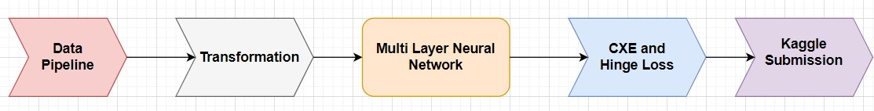
Multi layer Neural Network Pipeline

Slide 6
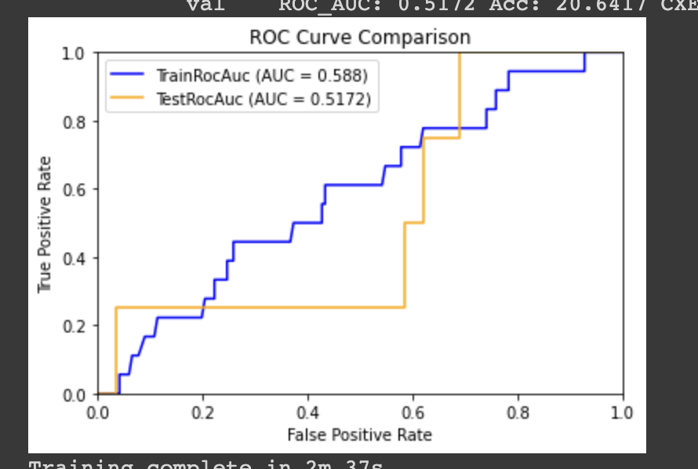
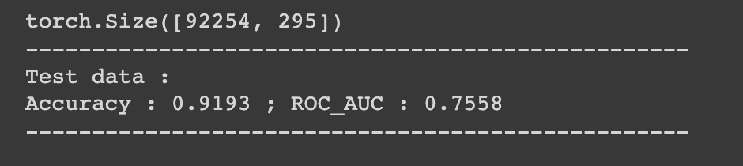
Experimental Results
Single layer neural network
Multi Layer Neural Network

Slide 7
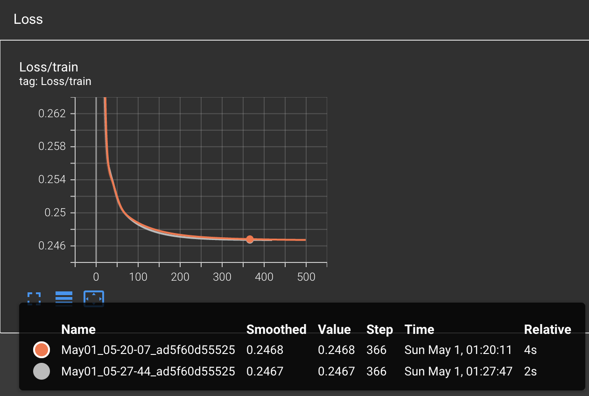
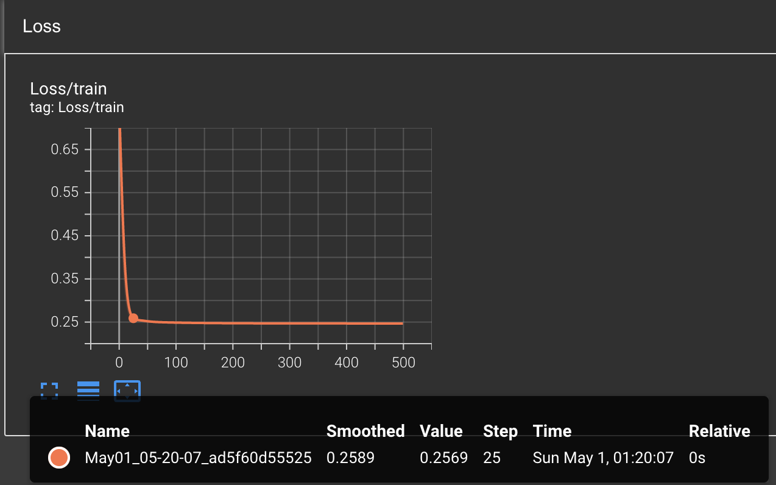
Tensor Board Results
CXE Loss (single Layer neural network)
CXE Loss (Multi Layer neural network)

Slide 8
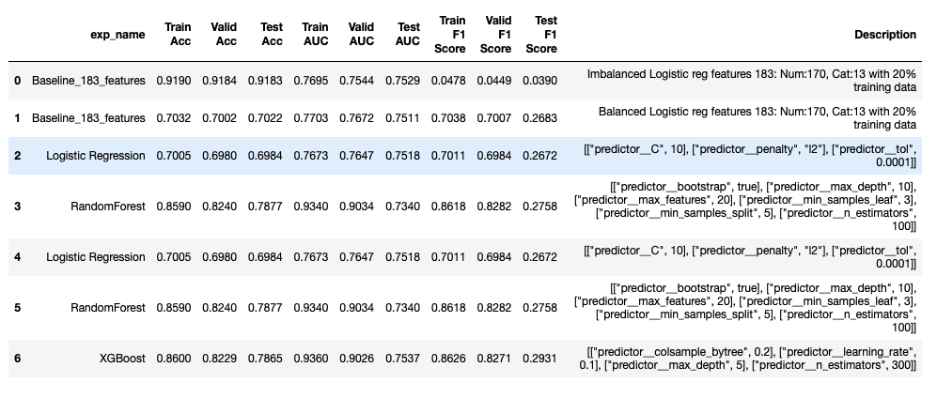
Experimental Results

Slide 9

Kaggle Submission for Multi Layer Neural Network Model

Slide 10
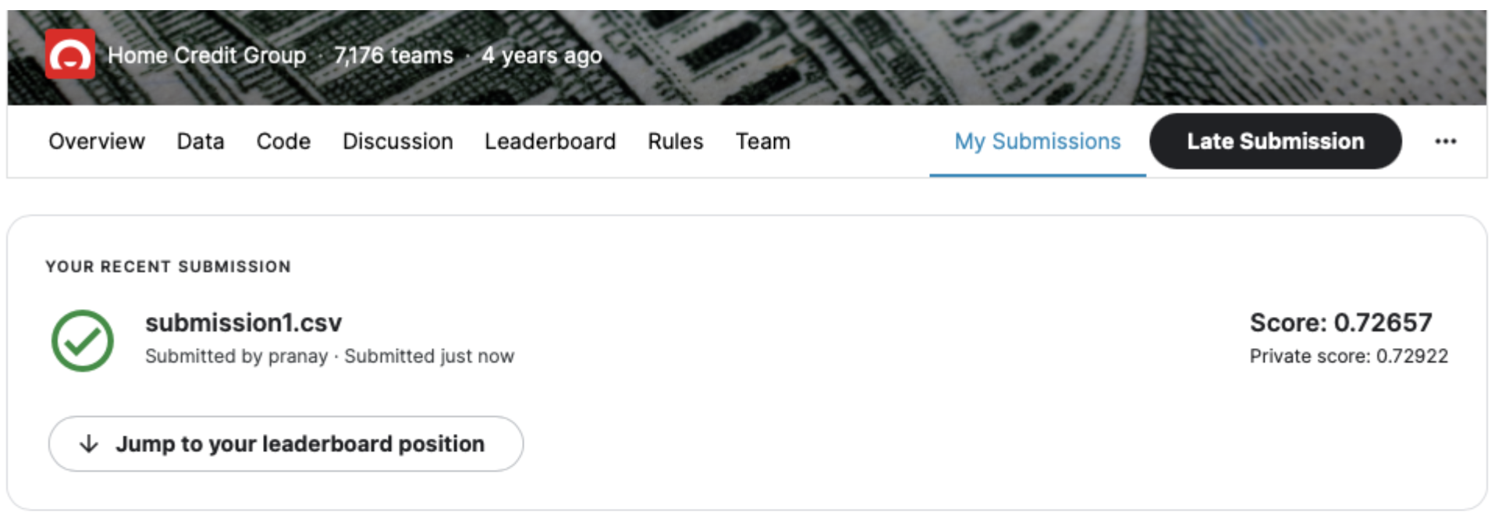
Kaggle Results

Slide 11
Data Leakage
Split the model by removing the target variable while training the model.
One hot Encoding, Standard Scaler & imputer techniques such as mean and most frequent items for categorical and numerical features.
Cross fold validations and validation set has been used while training the model.

Slide 12
Conclusion & Improvements
Trained logistic regression, Random forest, XGBoost and neural network models to predict if a loan borrower would default loan repayment or not.
XGBoost is the best model based on AUC scores.
As an extension we would like to add more hidden layers and explore different activation functions and process the models.
Explore important features to increase accuracy of multi layer neural network model.

Slide 13
THANK YOU

